Slide 1




Beyond Objective Integration
How belonging shapes norm perception in peer networks
Radek Rychlík^{1,2}, Adam Klocek^{1,3}, Lenka Kollerová¹,Tomáš Lintner^{1,4}
¹ Institute of Psychology, Czech Academy of Sciences
² Department of Psychology, Faculty of Social Studies, Masaryk University
³ Psychology Research Institute, Faculty of Social Studies, Masaryk University
⁴ Department of Educational Sciences, Faculty of Arts, Masaryk University
EARA 2026, Utrecht

Slide 2
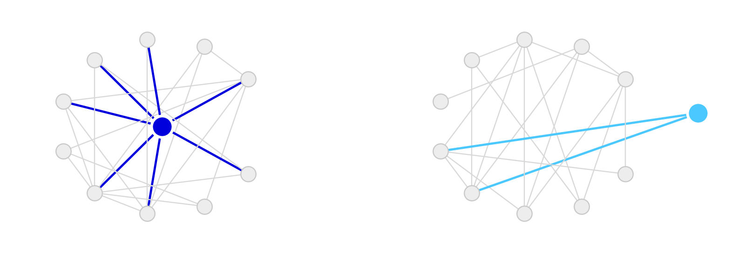
A judgement, not a description
“I don't really belong here”
“This is my class”
many ties, low belonging
few ties, high belonging
García-Bacete et al. (2005)
„…only 5% of children did not display any dyadic error“
Portillo & Fernández-Baena (2019)
87 % of popular adolescents underestimate how accepted they are.
67 % of neglected adolescents overestimate their nominations.
Notes:
Nobody sees the whole classroom. You see the part you are standing in.

Slide 3
Belonging as an interpretive lens
“…this hypothesis guides perception and interpretation. Evidence consistent with the hypothesis ‘I do not belong’ stands out in perception.”
Walton & Cohen (2007)
Objective position
acceptance and rejection nominations
Perceived classroom norms
weekly self-report
Subjective belonging
weekly self-report
Allen et al. (2021)
Belonging has no agreed measure, so both self-report and network position are used to stand for it.

Slide 4
Questions and hypotheses
1
How far do subjective belonging and objective network position diverge?
H1: Only moderately associated, related but distinct constructs.
2
Does subjective belonging predict later perceptions of classroom norms?
H2: Higher belonging predicts more prosocial perceived norms, controlling for network position.
3
Does the same hold from one week to the next?
H3: Weeks below a student's own average in belonging are followed by declines in perceived norms.
4
How do the subjective and objective sides jointly predict how students read the class?
Notes:
Aim 3, whether belonging spreads through peer ties, is not in this talk.

Slide 5
Sample and design
Data from The Moment of Change (GA ČR 25-15697S, PI Adam Klocek), Institute of Psychology, Czech Academy of Sciences
202
8
.91–.94
first-year students
weekly waves
belonging, α across waves
11
1,336
.81–.90
newly formed classrooms
student × week observations
perceived norms, α across waves
~18
2
15.9
students per class
cohorts, 121 and 81
average age
w1
w2
w3
w4
w5
w6
w7
w8
Notes:
Newly formed classes — they met in September, nobody arrived with a reputation. Measured weekly on their own phones.

Slide 6
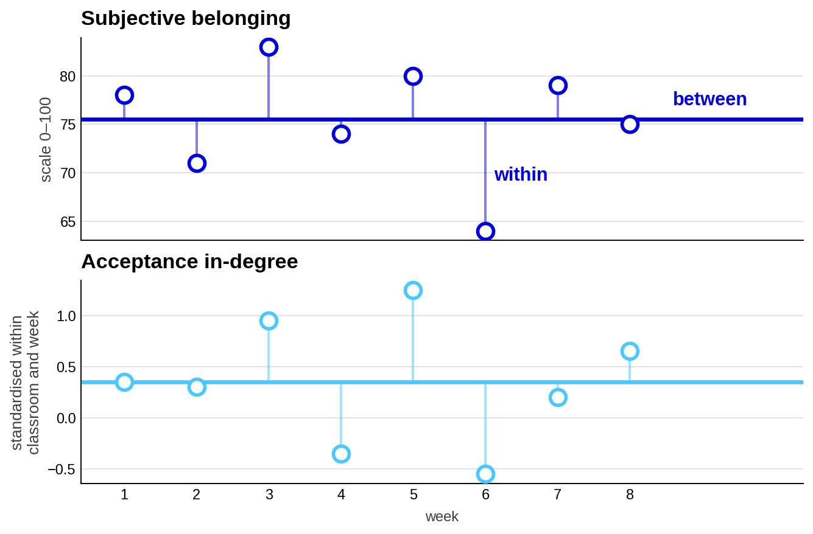
Measures
Subjective belonging
I felt I belong to my classroom.
I felt I can trust my classmates
My classmates treated me with respect.
I felt comfortable in the company of my classmates.
I felt valued by my classmates,
Perceived prosocial norms
I felt that the classmates behaved well to each other at the school.
I felt that helping each other was normal in the classroom.
I felt that differences among classmates were respected in the classroom.
Objective position
Who did you spend most time with in the past week?
Who did you avoid spending time with in the past week the most?
Notes:
Nominations ask who you spent time with and who you avoided — not who you like. Say this out loud. In-degree is standardised inside each classroom and week, so a value is how far above or below that class's average for that week a student sat. Everything after this slide depends on the split into a person mean and the weekly deviation from it.

Slide 7
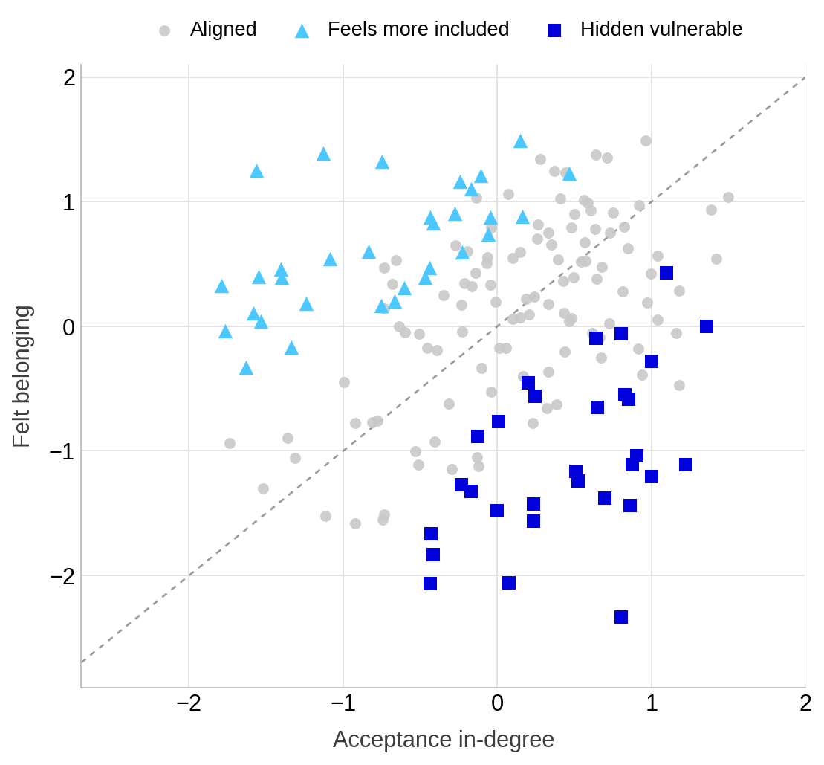
Subjective belonging and network position
r = .08 within a student
r = .11 between students
essentially zero for rejection
30 students consistently feel worse than
their position implies
32 students consistently feel better
than their position implies
of 173 students with at least five valid waves

Slide 8
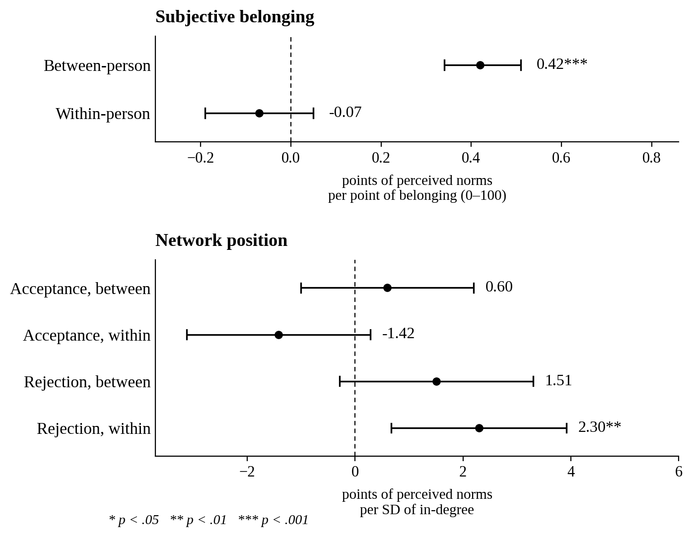
Predicting norms one week later
Predictor | b [95% CI] | p
Belonging, between | 0.42 [0.34, 0.51] | < .001
Belonging, within | -0.07 [-0.19, 0.05] | .241
Acceptance, between | 0.60 [-1.01, 2.20] | .461
Acceptance, within | -1.42 [-3.12, 0.28] | .100
Rejection, between | 1.51 [-0.29, 3.30] | .098
Rejection, within | 2.30 [0.67, 3.92] | .006
Norms at week t | 0.35 [0.28, 0.43] | < .001
Gender (female) | 2.89 [0.10, 5.69] | .043
Age (centered) | 0.45 [-2.02, 2.93] | .714
Cohort 2 | 0.23 [-2.34, 2.80] | .857
663 observations, 156 students
Notes:
Belonging between students 0.43. Within students -0.07. Acceptance splits into +0.60 between and -1.42 within. Rejection within students 2.30. Dark blue means the interval excludes zero.

Slide 9
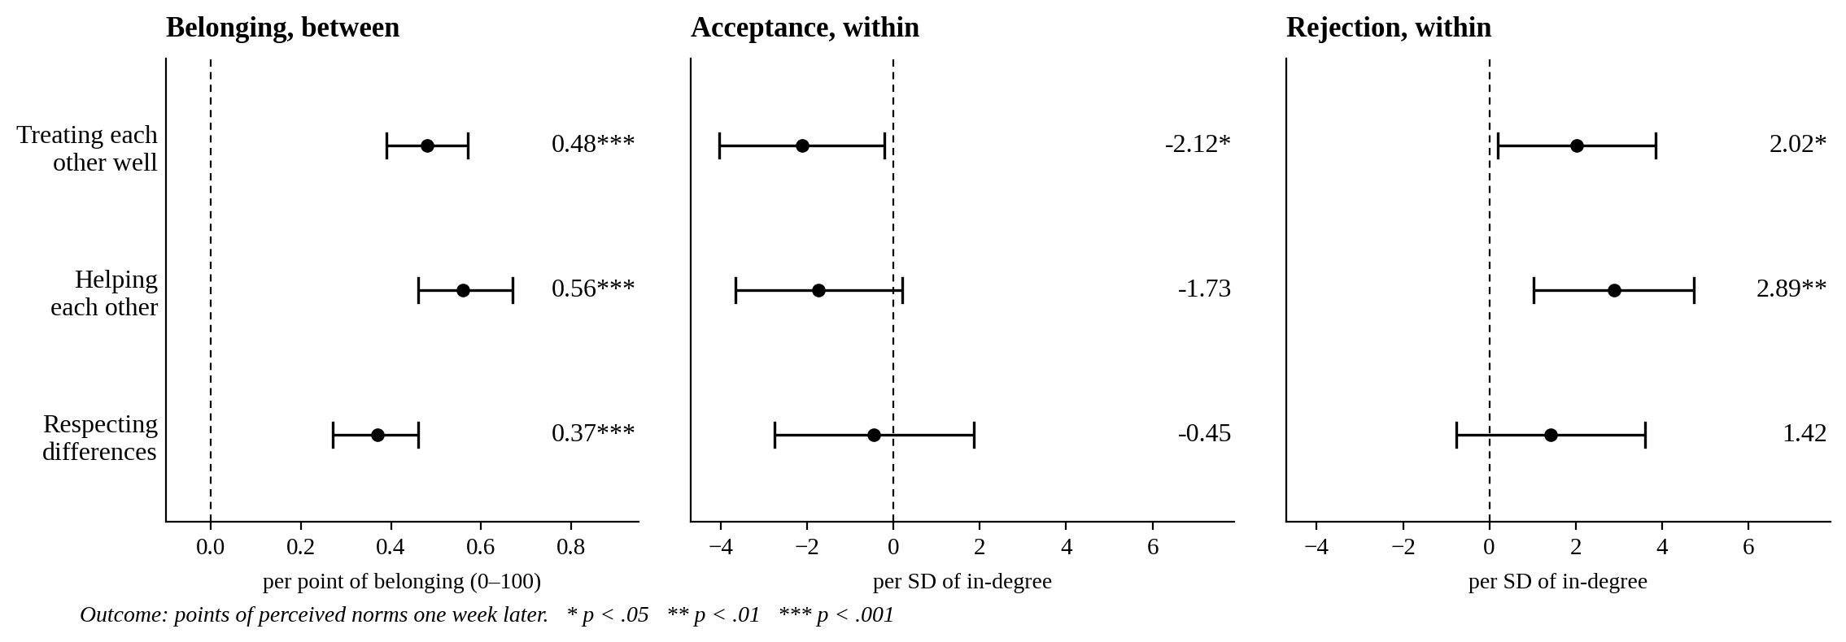
The three norm items separately
Notes:
Each column is the same specification with a different outcome — all six predictors, the item's own lagged value, and the covariates are in every model.

Slide 10
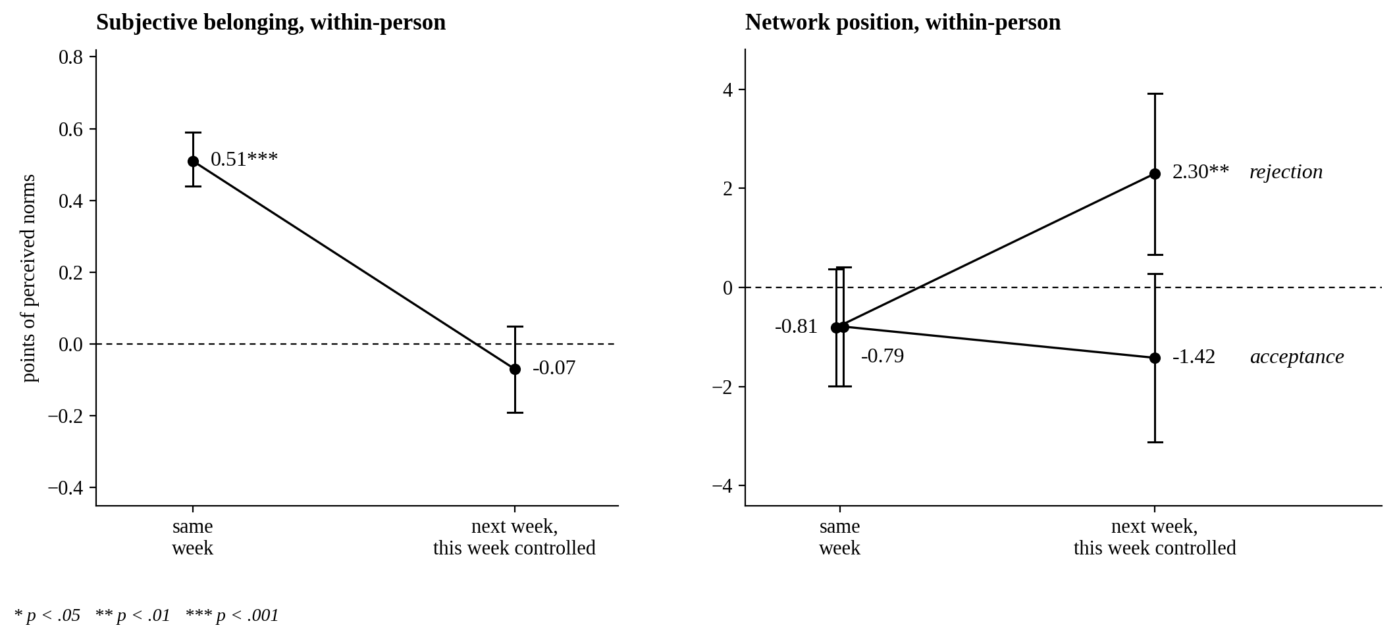
Same week and one week later
Characterological self-blame
The rejected student attributes what happened to something about themselves, rather than to the class: „it's something about the way I am“
Graham & Juvonen (1998, p. 588)
Notes:
The same-week half replicates Laninga-Wijnen and colleagues. The reversal I put to the room as a question — self-blame is my reading, not a conclusion.

Slide 11
Limitations
The design is observational.
We cannot rule out third variables. A few close friendships could explain why the sheer number of ties says so little.
Belonging and norms are both self-report.
Response style may account for part of the association.
The within-person test is the least powered.
Missingness was not random.
Lower belonging predicted missing a week, so these estimates are likely conservative.

Slide 12
Conclusions
1.
Subjective belonging and network position barely overlap, r ≈ .10.
2.
More than a third of students diverge systematically, in both directions.
3.
Between students, belonging predicts how they read the class a week later.
4.
Within a student, that happens in the same week only, and nothing carries over.
5.
Rejection predicts more prosocial norms a week later; acceptance runs negative.

Slide 13
Thank you for your attention.
radek.rychlik@mail.muni.cz
This work was supported by the Czech Science Foundation, grant no. 25-15697S.

Slide 14
References
Allen, K. A., Kern, M. L., Rozek, C. S., McInerney, D. M., & Slavich, G. M. (2021). Belonging: A review of conceptual issues, an integrative framework, and directions for future research. Australian Journal of Psychology, 73(1), 87–102.
Baumeister, R. F., & Leary, M. R. (1995). The need to belong: Desire for interpersonal attachments as a fundamental human motivation. Psychological Bulletin, 117(3), 497–529.
Graham, S., & Juvonen, J. (1998). Self-blame and peer victimization in middle school: An attributional analysis. Developmental Psychology, 34(3), 587–599.
Ross, L., Greene, D., & House, P. (1977). The “false consensus effect”: An egocentric bias in social perception and attribution processes. Journal of Experimental Social Psychology, 13(3), 279–301.
Salmivalli, C., & Voeten, M. (2004). Connections between attitudes, group norms, and behaviour in bullying situations. International Journal of Behavioral Development, 28(3), 246–258.
García-Bacete, F. J., Marande-Perrin, G., Schneider, B. H., & Cillessen, A. H. N. (2019). Children's awareness of peer rejection and teacher reports of aggressive behavior. Psychosocial Intervention, 28(1), 37–47.
Portillo, M., & Fernández-Baena, J. (2020). Social self-perception in adolescents: Accuracy and bias in their perceptions of acceptance/rejection. Psicología Educativa, 26(1), 1–6.
Walton, G. M., & Cohen, G. L. (2007). A question of belonging: Race, social fit, and achievement. Journal of Personality and Social Psychology, 92(1), 82–96.

